Slide 1
Ch5 Review Logarithms

Slide 2
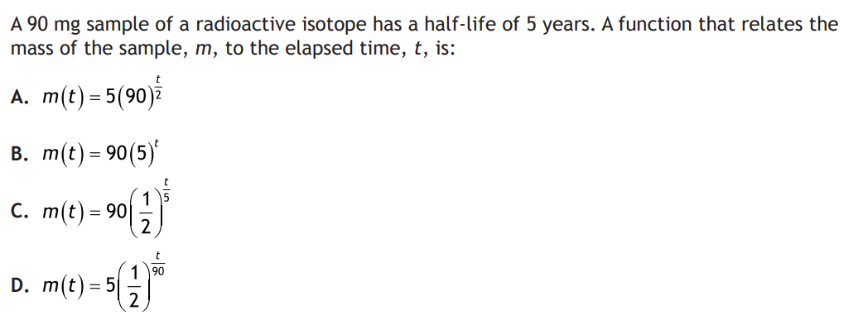

Slide 3
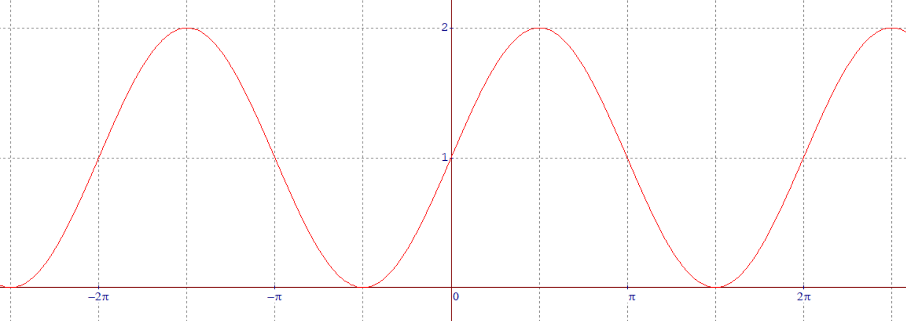

Which of the following is the correct graph of the equation:
Log(y)=log[sin(x)+1]
A
B
C
v

Slide 4
What is the domain of the function:

Slide 5
The population (P) of a country is depreciating continuously at an annual rate of 2.5%, meaning that the population is equal to 97.5% of its previous year. Which of the following is the correct formula for the population of the country in 20 years?

Slide 6
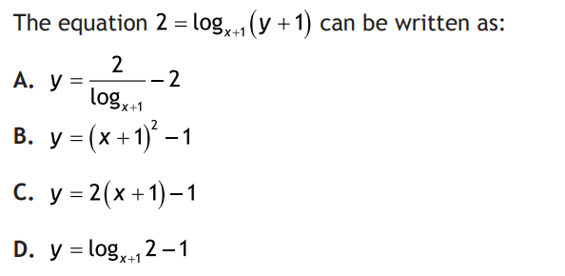

Slide 7
The following expression can be rewritten as:

Slide 8
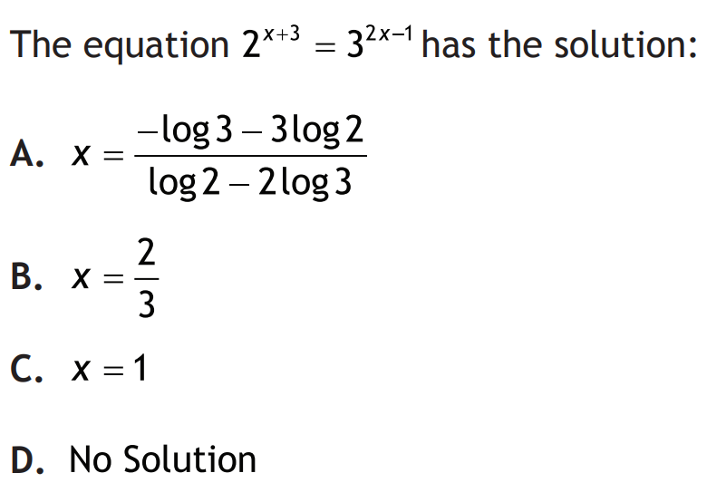

Slide 9
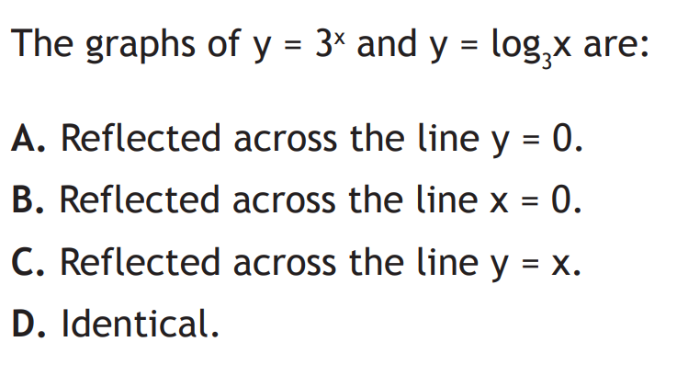

Slide 10
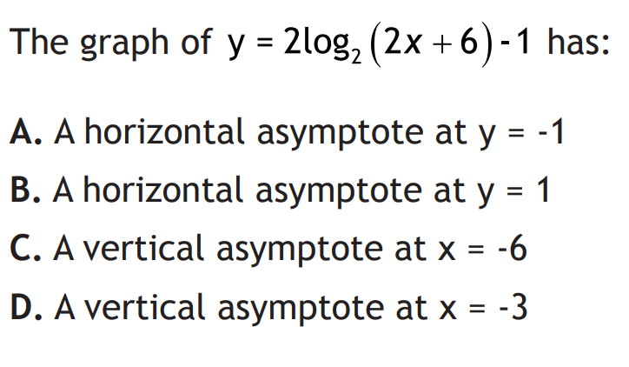

Slide 11
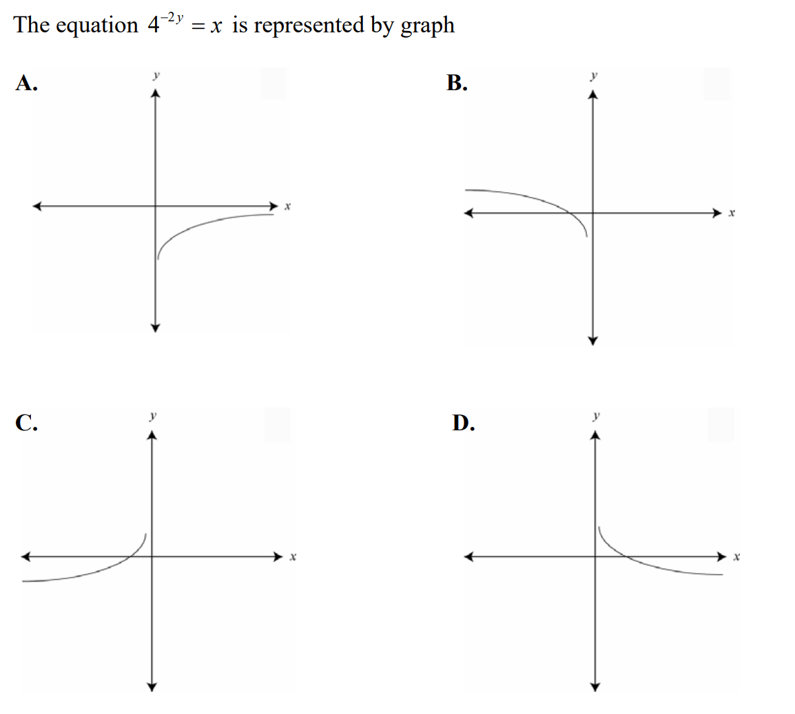

Slide 12


Slide 13
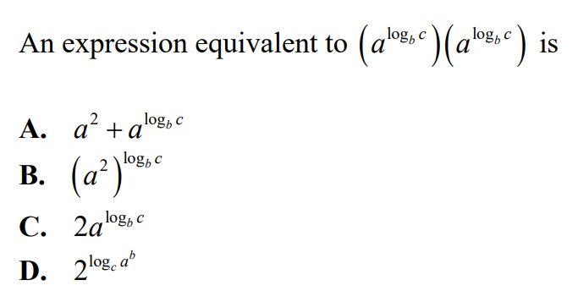

Slide 14

Given the system of equations:
What is the value of $a×b$?
Add the equations:

Slide 15
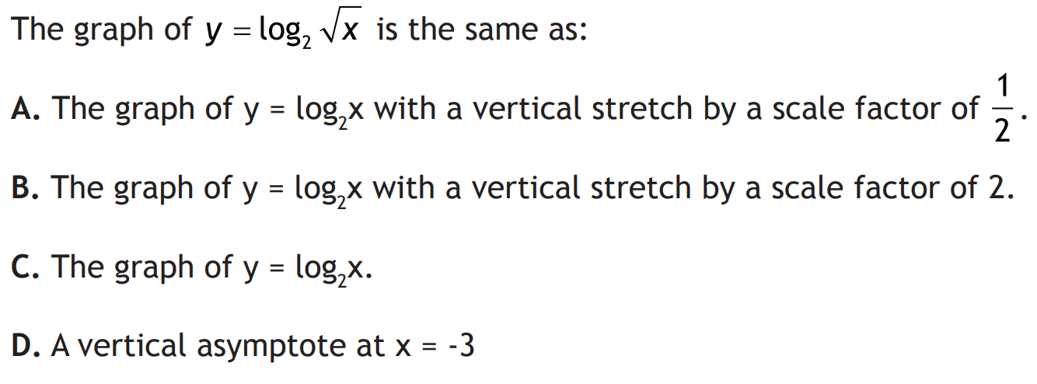

Slide 16
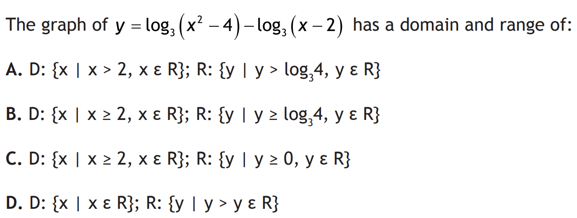

Slide 17
Given the equation, solve for “x”

Slide 18


Slide 19

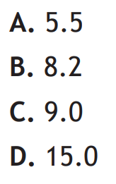

Slide 20


Slide 21



Take the third equation and simplify it

Slide 22
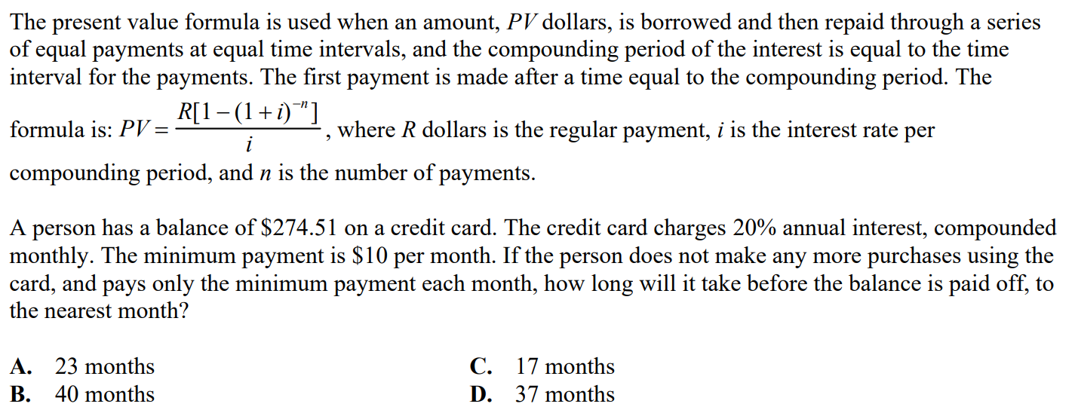

Slide 23
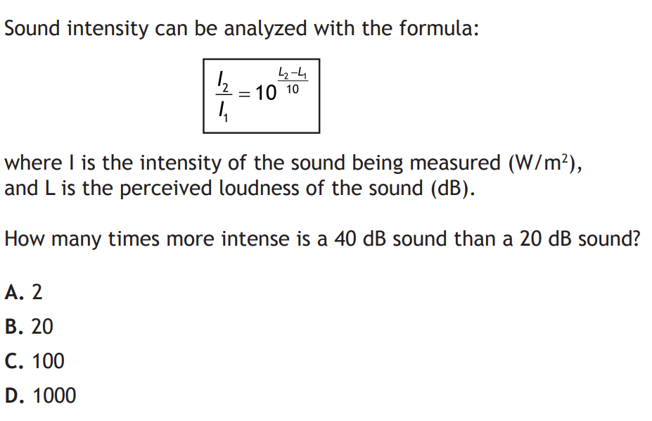

Slide 24
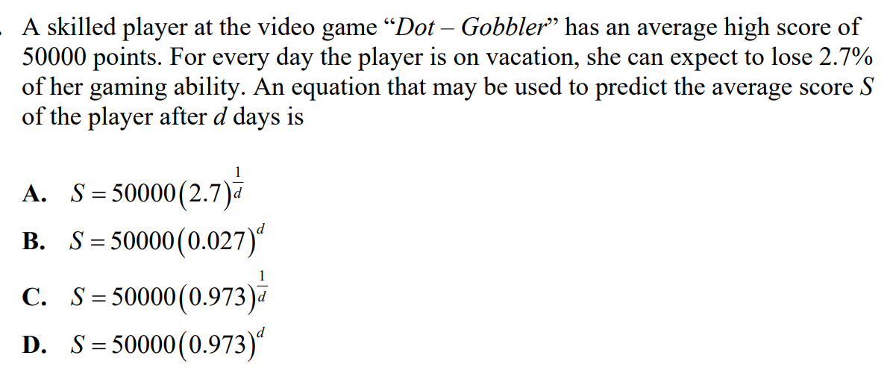

Slide 26
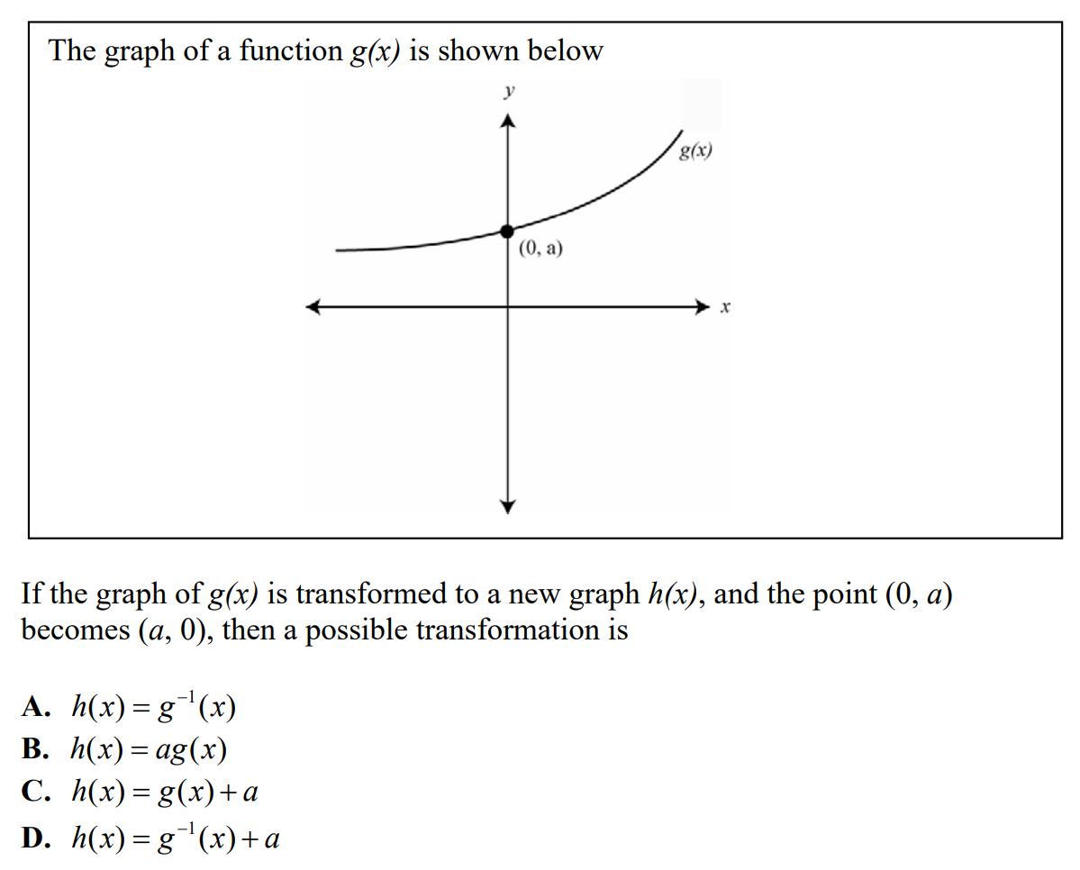

Slide 27


Slide 28


Slide 29



